Slide 1
Procurement management

Slide 2
Content
Introduction
Project Procurement Management
Outsourcing

Slide 3
Importance of Project Procurement Management
Procurement means acquiring goods and/or services from an outside source
Other terms include purchasing and outsourcing

Slide 4
Reasons
Current software no longer meets your needs.
It is unable to provide valuable information;
Does not support your current business process;
Is difficult to maintain
Is frequently unavailable due to system failures.

Slide 5
Introduction
Company needs a completely new software application to support a specific business process.
Decision to make/buy/outsource
Should you purchase an off-the-shelf product or build custom software?
If you decide to build, should you build the software in-house or outsource the project to a third party vendor?
If you decide to outsource, should you use an onshore or offshore development organization?
Notes:
Your current software no longer meets your needs. It is unable to provide valuable information; does not support your current business process; is difficult to maintain or is frequently unavailable due to system failures. Or, perhaps your company needs a completely new software application to support a specific business process. Whatever the case, you are probably trying to decide how you should proceed.
Should you purchase an off-the-shelf product or build custom software? If you decide to build, should you build the software in-house or outsource the project to a third party vendor? If you decide to outsource, should you use an onshore or offshore development organization?

Slide 6
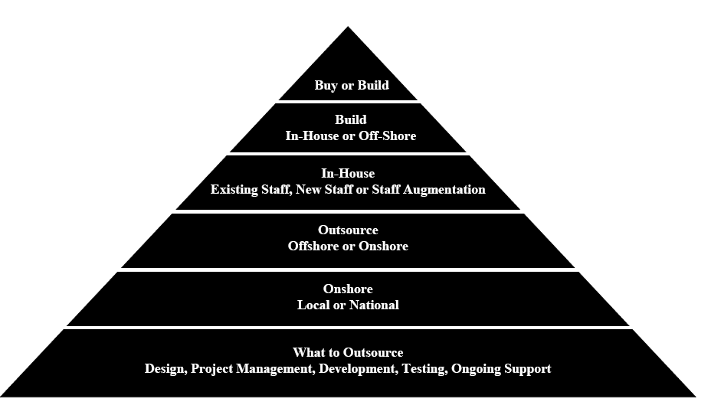
Strategy

Slide 7
Buy (COTS)
When To Consider Off-the-Shelf Software
Many viable products available
Business processes are flexible
Customized branding is not required
Integration with other applications is limited
Implementation timeline is short
Per-seat or per-license fees are acceptable
Adding new product features is not critical
Notes:
When To Consider Off-the-Shelf Software
Many viable products available
Business processes are flexible
Customized branding is not required
Integration with other applications is limited
Implementation timeline is short
Per-seat or per-license fees are acceptable
Adding new product features is not critical

Slide 8
Perceived Benefits if bought
Lower initial costs
Reduced time to deployment
Higher success rate
Availability of training and support
Access to user manuals and documentation

Slide 9
Build
A comprehensive technical skill assessment
hire additional developers or augment your staff with contract engineers.
how long it will take to develop the application in-house
A financial analysis of an internal project
Notes:
Since not all IT departments and software developers have the same expertise, it will be important to analyze the capabilities of your company’s development team. Simply asking your developers if they can handle the project is not enough. A comprehensive technical skill assessment is
strongly advised. If you determine upon completion of the skills assessment that you do not have the bandwidth or the skills needed to complete the project but still would like to complete the project in-house, you can hire additional developers or augment your staff with contract engineers.
However, a careful interview process is recommended so you select the right technical resources for your project.
Another factor to consider is how long it will take to develop the application in-house. There is often a communication gap between management and developers; management looks at the world from 50,000 feet and developers focus on granular details. As a result, what may appear as a small additional request from management may require months of programming to incorporate it into the application.
To ensure the project stays on track, it will be critical to define requirements, deliverables and timelines at the beginning of the project and keep future changes to a minimum.
A financial analysis of an internal project is recommended. Whether you are using internal employees or on-site contractors, there can be significant development and opportunity costs. For example, internal employees have other responsibilities that will be interrupted due to the new development project. Therefore, the opportunity costs associated with not performing regular tasks and responsibilities will be a cost to the company. In the case of contractors who are hired to augment your internal staff, you will want to add the cost of training and additional technology resources that are consumed to the hourly rate you will be charged.

Slide 10
Common challenges
Common challenges that can impede a project’s progress:
Unrealistic deadlines from management
Vague definition of project deliverables
Inadequate time allotted for software design
Little or no beta testing
Internal politics
Poor estimating techniques (time and cost)
Lack of a quality assurance process
Lack of proper project management
Insufficient resources for ongoing maintenance and
support
Documentation that is overlooked or avoided
Notes:
common
challenges that can impede a project’s progress:
Unrealistic deadlines from management
Vague definition of project deliverables
Inadequate time allotted for software design
Little or no beta testing
Internal politics
Poor estimating techniques (time and cost)
Lack of a quality assurance process
Lack of proper project management
Insufficient resources for ongoing maintenance and
support
Documentation that is overlooked or avoided

Slide 11
When To Consider In-House Software
Software requirements are unique
Internal development staff has expertise
In-house staff has bandwidth
Extensive integration is required
Implementation timeline is flexible
Customized features are needed
Ability to make changes is critical

Slide 12
In-House Software Perceived Benefits
Software built around specific requirements
Complete control over future development
Clear understanding of how the software works
Unique features that will create a competitive advantage
Lower cost to develop and support
Notes:
Perceived Benefits
Software built around specific requirements
Complete control over future development
Clear understanding of how the software works
Unique features that will create a competitive
advantage
Lower cost to develop and support

Slide 13
When To Consider Outsourcing
No in-house development staff
In-house staff lacks bandwidth
Specific features and functions are required
Must be deployed as quickly as possible
Prefer a single capital expenditure
Quality control and testing are critical
Require the flexibility of custom software with the ease of a product
Notes:
When To Consider Outsourcing
No in-house development staff
In-house staff lacks bandwidth
Specific features and functions are required
Must be deployed as quickly as possible
Prefer a single capital expenditure
Quality control and testing are critical
Require the flexibility of custom software with the ease
of a product

Slide 14
Why Outsource?
To reduce both fixed and recurrent costs
To allow the client organization to focus on its core business
To access skills and technologies
To provide flexibility
To increase accountability

Slide 15
Outsourcing - Perceived Benefits
Reduced project and financial risk
Clearly defined requirements and deliverables
Most up-to-date design capabilities
Reduced project timeline and budget
Easy to maintain and enhance
Unique features will create a competitive advantage
Notes:
Perceived Benefits
Reduced project and financial risk
Clearly defined requirements and deliverables
Most up-to-date design capabilities
Reduced project timeline and budget
Easy to maintain and enhance
Unique features will create a competitive advantage

Slide 16
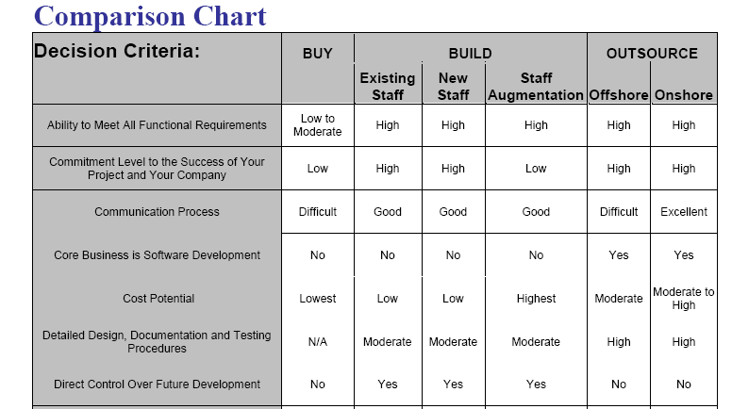

Slide 17
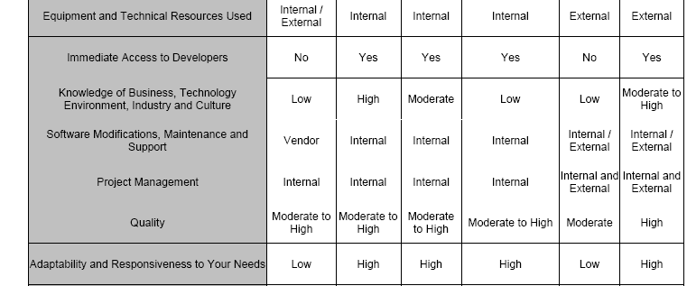

Slide 18
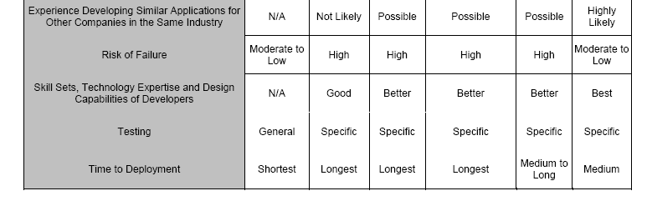

Slide 19
Learning Objectives
Describe the source selection process and different approaches for evaluating proposals or selecting suppliers
Discuss the importance of good contract administration
Describe the contract close-out process
Discuss types of software available to assist in project procurement management

Slide 20
Project Procurement Management Processes
Procurement planning: determining what to procure and when
Solicitation planning: documenting product requirements and identifying potential sources
Solicitation: obtaining quotations, bids, offers, or proposals as appropriate
Source selection: choosing from among potential vendors
Contract administration: managing the relationship with the vendor
Contract close-out: completion and settlement of the contract

Slide 21
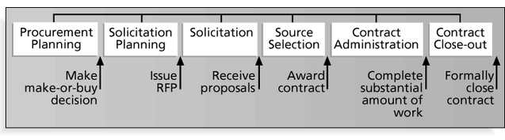
Project Procurement Management Processes and Key Outputs

Slide 22
Procurement Planning
Procurement planning involves identifying which project needs can be best met by using products or services outside the organization.
It includes deciding
whether to procure
how to procure
what to procure
how much to procure
when to procure

Slide 23
Procurement Planning Tools and Techniques
Make-or-buy analysis: determining whether a particular product or service should be made or performed inside the organization or purchased from someone else.
Often involves financial analysis
Experts, both internal and external, can provide valuable inputs in procurement decisions

Slide 24
Make-or Buy Example
Assume you can lease an item you need for a project for $150/day. To purchase the item, the investment cost is $1,000, and the daily cost would be another $50/day.
How long will it take for the lease cost to be the same as the purchase cost?
If you need the item for 12 days, should you lease it or purchase it?

Slide 25
Make-or Buy Solution
Set up an equation so the “make” is equal to the “buy”
In this example, use the following equation. Let d be the number of days to use the item.
$150d = $1,000 + $50d
Solve for d as follows:
Subtract $50d from the right side of the equation to get
$100d = $1,000
Divide both sides of the equation by $100
d = 10 days
The lease cost is the same as the purchase cost at 10 days
If you need the item for 12 days, it would be more economical to purchase it

Slide 26
Types of Contracts
Fixed-price or lump-sum: involve a fixed total price for a well-defined product or service
Cost-reimbursable: involve payment to the seller for direct and indirect costs
Time and material contracts: hybrid of both fixed-price and cost-reimbursable, often used by consultants
Unit price contracts: require the buyer to pay the seller a predetermined amount per unit of service

Slide 27
Cost Reimbursable Contracts
Cost plus incentive fee (CPIF): the buyer pays the seller for allowable performance costs plus a predetermined fee and an incentive bonus
Cost plus fixed fee (CPFF): the buyer pays the seller for allowable performance costs plus a fixed fee payment usually based on a percentage of estimated costs
Cost plus percentage of costs (CPPC): the buyer pays the seller for allowable performance costs plus a predetermined percentage based on total costs

Slide 28
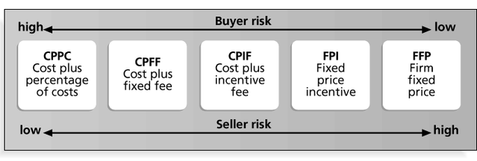
Contract Types Versus Risk

Slide 29
Statement of Work (SOW)
A statement of work is a description of the work required for the procurement
Many contracts, or mutually binding agreements, include SOWs
A good SOW gives bidders a better understanding of the buyer’s expectations

Slide 30
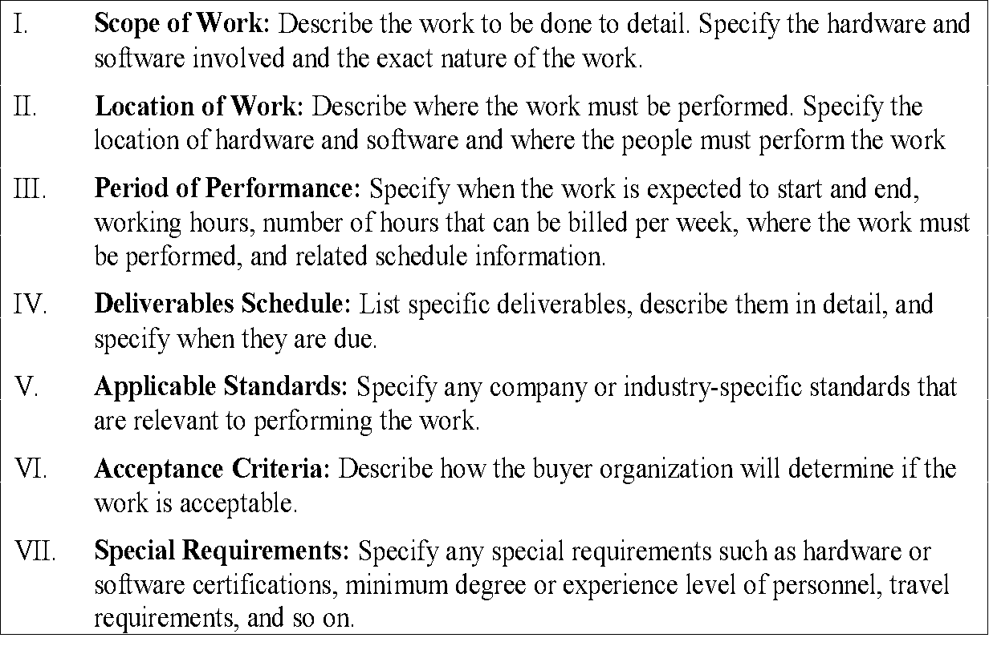
Statement of Work (SOW) Template

Slide 31
Solicitation Planning
Solicitation planning involves preparing several documents:
Request for Proposals: used to solicit proposals from prospective sellers
Requests for Quotes: used to solicit quotes for well-defined procurements
Invitations for bid or negotiation and initial contractor responses are also part of solicitation planning

Slide 32
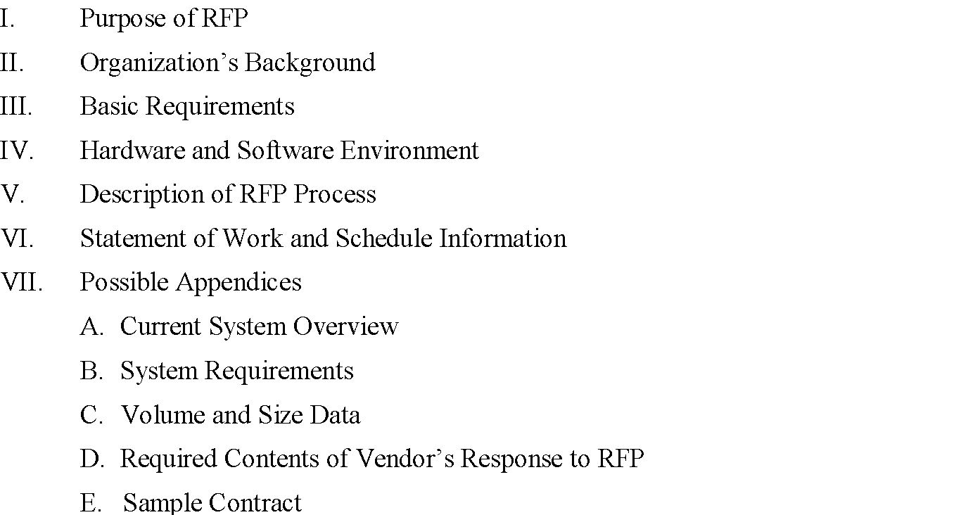
Outline for a Request for Proposal (RFP)

Slide 33
Solicitation
Solicitation involves obtaining proposals or bids from prospective sellers
Organizations can advertise to procure goods and services in several ways
approaching the preferred vendor
approaching several potential vendors
advertising to anyone interested
A bidders’ conference can help clarify the buyer’s expectations

Slide 34
Source Selection
Source selection involves
evaluating bidders’ proposals
choosing the best one
negotiating the contract
awarding the contract
It is helpful to prepare formal evaluation procedures for selecting vendors
Buyers often create a “short list”

Slide 35
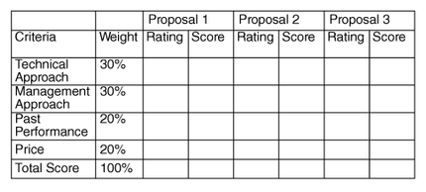
Sample Proposal Evaluation Sheet

Slide 36
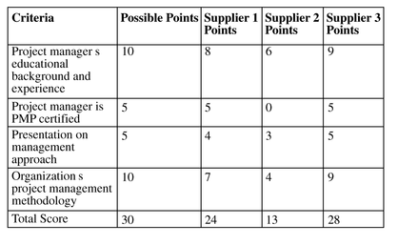
Detailed Criteria for Selecting Suppliers

Slide 37
Be Careful in Selecting Suppliers and Writing Their Contracts
Many dot-com companies were created to meet potential market needs, but many went out of business, mainly due to
poor business planning
lack of senior management operations experience,
lack of leadership, and lack of visions.
Check the stability of suppliers
Even well-known suppliers can impede project success. Be sure to write and manage contracts well with all suppliers

Slide 38
Contract Administration
Contract administration ensures that the seller’s performance meets contractual requirements
Contracts are legal relationships, so it is important that legal and contracting professionals be involved in writing and administering contracts
Many project managers ignore contractual issues, which can result in serious problems

Slide 39
Suggestions on Change Control for Contracts
Changes to any part of the project need to be reviewed, approved, and documented by the same people in the same way that the original part of the plan was approved
Evaluation of any change should include an impact analysis.
How will the change affect the scope, time, cost, and quality of the goods or services being provided?
Changes must be documented in writing. Project team members should also document all important meetings and telephone calls

Slide 40
Contract Close-out
Contract close-out includes
product verification to determine if all work was completed correctly and satisfactorily
administrative activities to update records to reflect final results
archiving information for future use
Procurement audits identify lessons learned in the procurement process

Slide 41
Using Software to Assist in Project Procurement Management
Word processing software helps in writing proposals and contracts, spreadsheets help in evaluating suppliers, databases help track suppliers, and presentation software aids in presenting procurement-related information
In the late 1990s and early 2000s, many companies started using e-procurement software to do many procurement functions electronically
Companies such as Commerce One, Ariba, Concur Technologies, SAS, and Baan provide corporate procurement services over the Internet
Organizations also use other Internet tools to help find information on suppliers or auction goods and services

Slide 42
Acquiring IS system

Slide 43
Introduction
Acquiring new systems go beyond building in-house
Nowadays company can decide which IT task will remain in-house which will be provided and managed by outside organization

Slide 44
Planning
Need for application
Cost- benefit
This project versus other projects
Strategic planning process changes its objectives according to changing markets and opportunities
Strategic plan includes both technical and managerial aspects
Notes:
Technical – hw,sw, os, nw dbase, other applns
Managerial – involvement of fnal area mgrs and how IT decisions will be made

Slide 45
Objectives of IT strategic plan
Alignment – example
Company that would like to improve customer service at any minimum cost
Company that provides product/service at low cost
Both have different objective
It must provide IT architecture that seamlessly connect to users, application and databases
IT development resources should be adequately assigned to finish the project in time, in budget and with required functionality

Slide 46
IT steering committee
comprises of group of managers, staff who establish IT priorities – develop IS operational plan
Mission
IS environment
Objectives
Constraints on IT function
Resource allocation and PM

Slide 47
Evaluating IT investment
Fixed cost
Operational cost
Maintenance cost
Assess benefits – using, NPV, ROI, BVA

Slide 48
Strategies for acquiring IT applications
How much company want to code?
Companies can buy prewritten apps (COTS)
Depending on funds available can rent / lease
Where to run the application?
SaaS vendor or application service provider.
Choose between open- source software or from a vendor.
Customize it in-house or out-source

Slide 49
Some acquisition methods
COTS
Customize prewritten application
Lease the application
Use SaaS vendor or application service provider.
Use open-source software
Use outsourcing
Employ custom development

Slide 50
Vendor and software selection
Identify potential vendors
Determine evaluation criteria
Evaluate vendors and packages
Negotiate a contract
Establish service-level agreements.

